Slide 1
Status of the TWiLiTE Direct Detection Doppler Lidar Bruce Gentry¹, Huailin Chen², Jaime Cervantes², Steve Mitchell³, Roman Machan³, Daniel Reed³ May 2, 2012
Acknowledgements:
TWiLiTE was developed with support from the NASA ESTO IIP program. Additional support was provided by the Airborne Instrument Technology Transition program, Dr. Ramesh Kakar, Program Manager

Slide 2
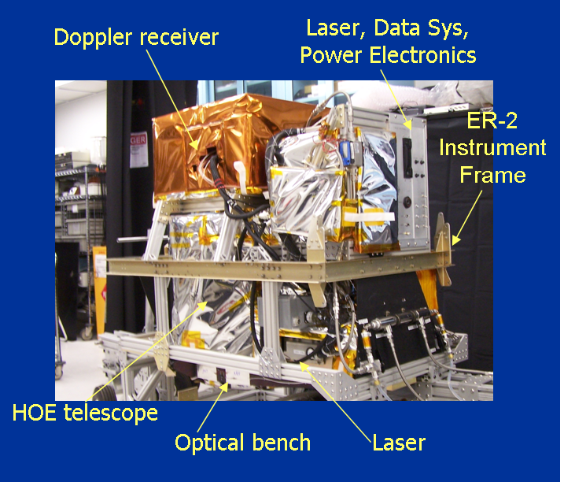
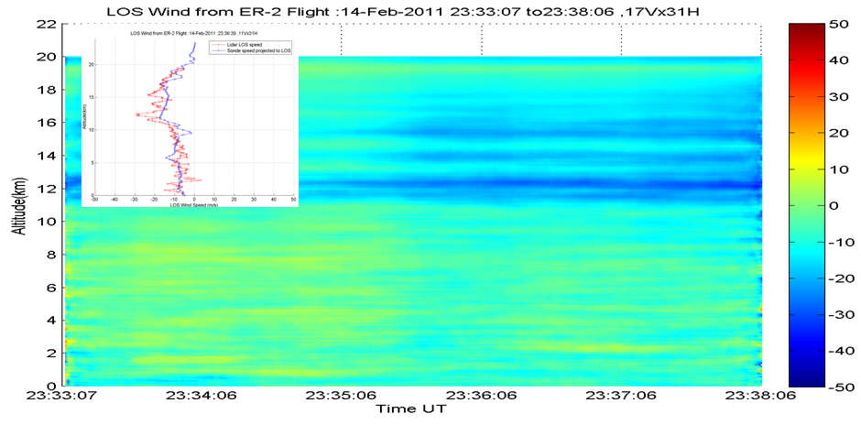
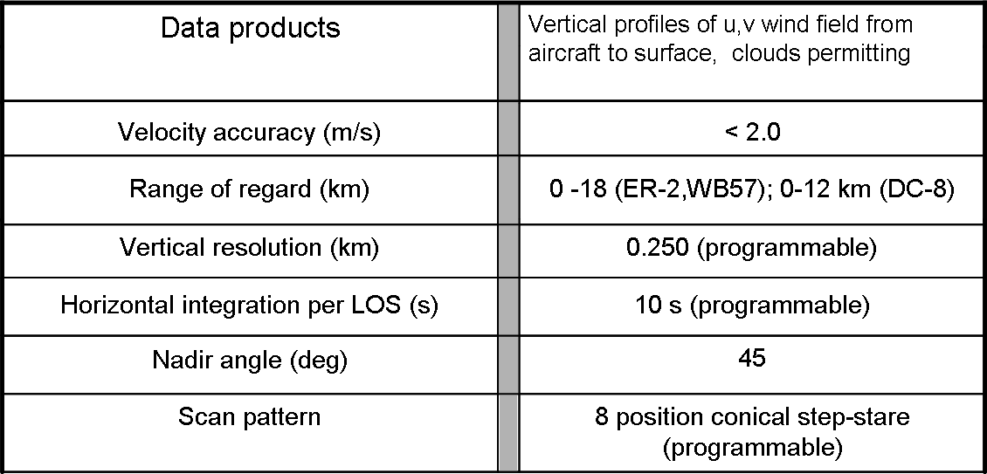
Tropospheric Wind Lidar Technology Experiment (TWiLiTE) IIP
The TWiLiTE instrument is a compact, rugged direct detection scanning Doppler lidar designed to measure wind profiles in clear air from 20 km to the surface.
TWiLiTE operates autonomously on NASA research aircraft (ER-2, DC-8, WB-57, Global Hawk).
Engineering flight tests on the NASA ER-2 in 2009 and 2011 demonstrated autonomous operation of all major systems.
TWiLiTE will be reconfigured to fly on the NASA Global Hawk as part of the Hurricane and Severe Storm Sentinel Earth Venture Class Mission.
TWiLiTE system configured for ER-2 QBay
TWiLiTE LOS wind profiles from Feb 14, 2011 ER2 test flight. A 10 minute segment taken over Fresno, CA is shown. Inset is a single TWiLiTE profile compared with wind profile data from the 00Z, Feb 15 NWS radiosonde launched from Oakland, CA.
Notes:
TWiLiTE is a 3 year technology development program funded by ESTO under the IIP.
TWiLiTE Supports the 3DWinds NRC Decadal Survey Mission. It represents the direct detection molecular or ‘clear air’ portion of the recommended ‘Hybrid Doppler lidar concept’. The coherent Doppler utilizes aerosol backscatter ahs complementery measurement capabilities and is the other half of the Hybrid concept.
The TWiLiTE Doppler lidar measures wind profiles by measuring the Doppler shift of the laser backscattered return from molecules in the atmosphere.
Designed to measure full profiles of horizontal winds from the flight altitude of the NASA ER2 (20 km) to the surface with 250 m vertical resolution and <2 m/s accuracy
Advances TRL of key technologies identified for future space missions e.g the single frequency uv NdYAG laser; the molecular Doppler receiver; Tunable fabry Perot etalon filter and the rotating conically scanned telescope.
These technologies were demonstrated at the system level in initial engineering flights of TWiLiTE on the NASA ER-2 high altitude aircraft in September, 2009. Exit TRL from the IIP is 5.
Additional flight tests of TWiLiTE on the ER-2 are planned for Fall, 2010.
TWiLiTE will be reconfigured to fly in the NASA Global Hawk as part of the Hurricane and Severe Storm Sentinel (HS3) Venture Class Mission.

Slide 3
TWiLiTE Instrument Parameters
Wavelength 354.7 nm
Telescope/Scanner Area 0.08 m²
Laser Linewidth (FWHH) 150 MHz
Laser Energy/Pulse (8 W) 40 mJ @ 200 pps
Etalon FSR 16.65 GHz
Etalon FWHH 2.84 GHz
Edge Channel Separation 6.64 GHz
Locking Channel Separation 4.74 GHz
Interference filter BW (FWHH) 120 pm
PMT Quantum Efficiency 25%

Slide 4
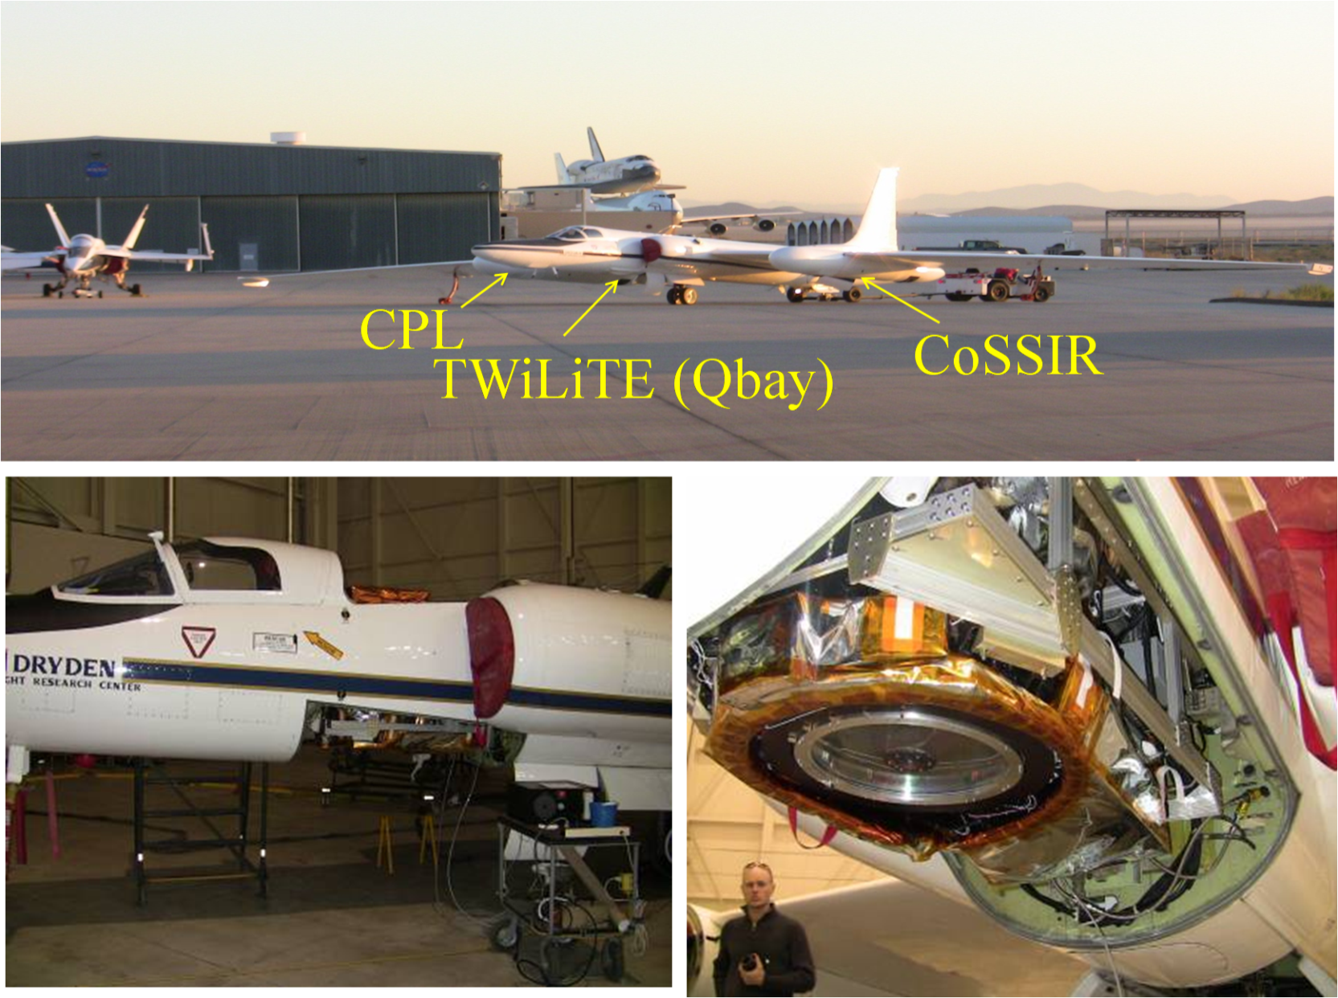
ER-2 Engineering Flights October, 2009 & February, 2011

Slide 5
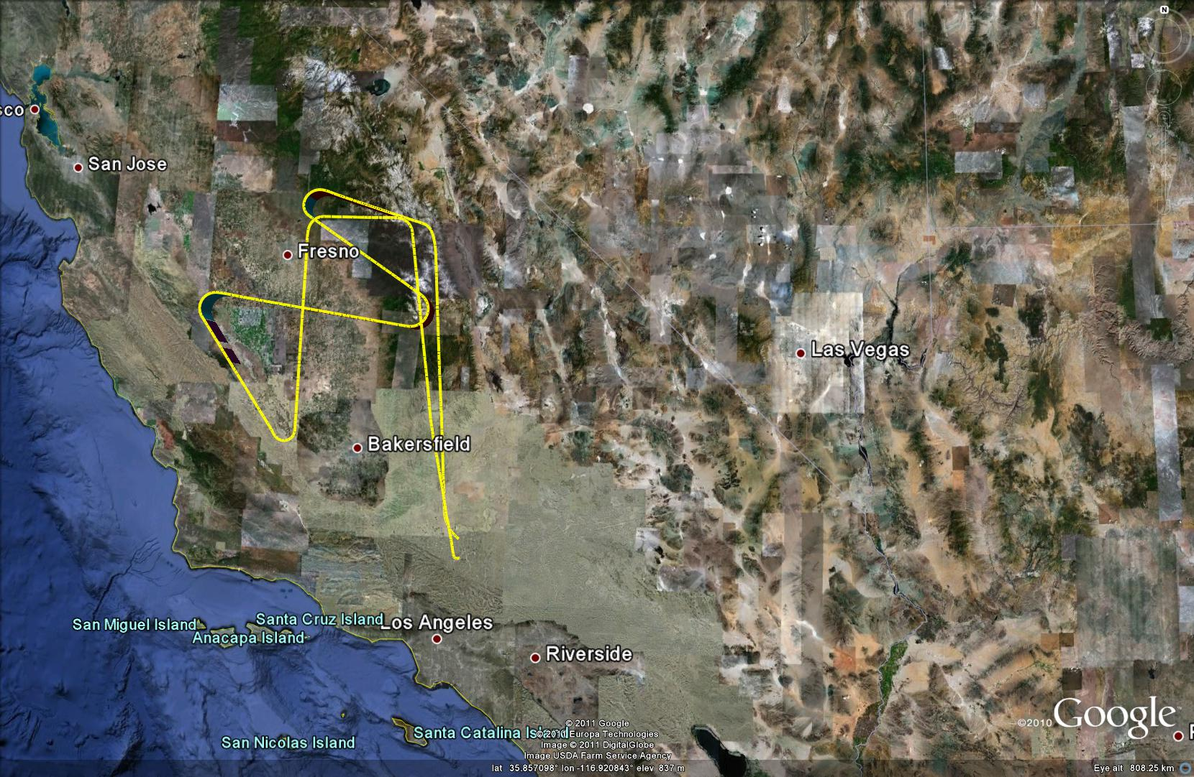
February 14, 2011 flight over California Central Valley

Slide 6
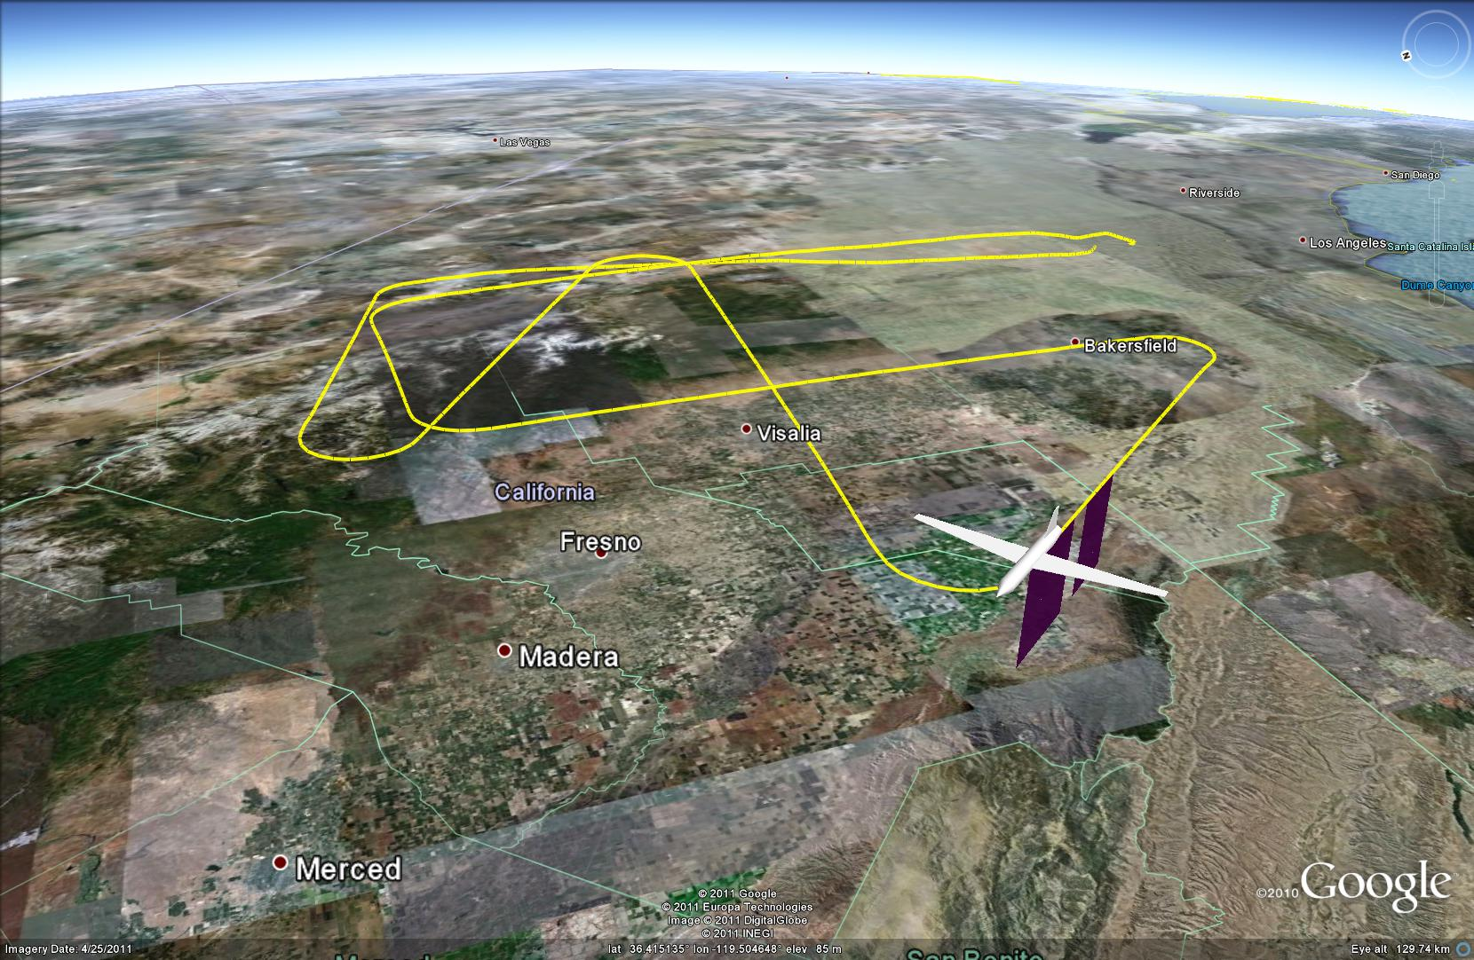
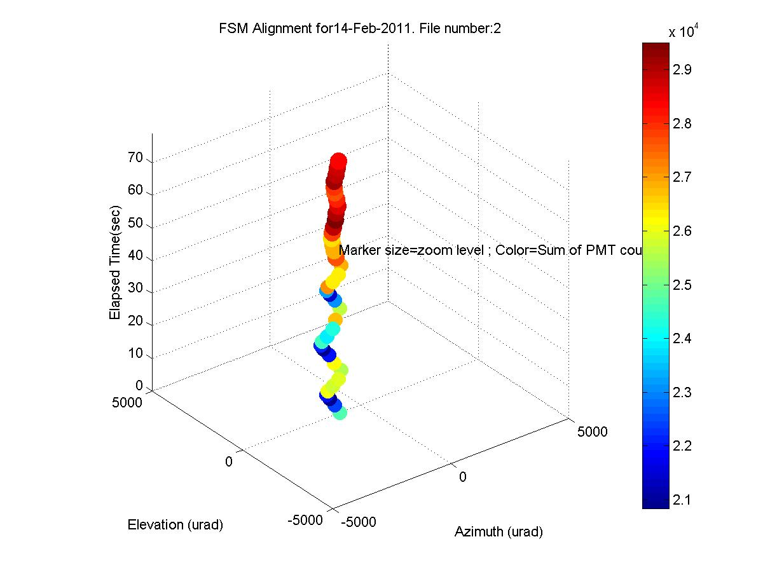
TWiLiTE Flight Test Modes Fast Steering Mirror Alignment

Slide 7
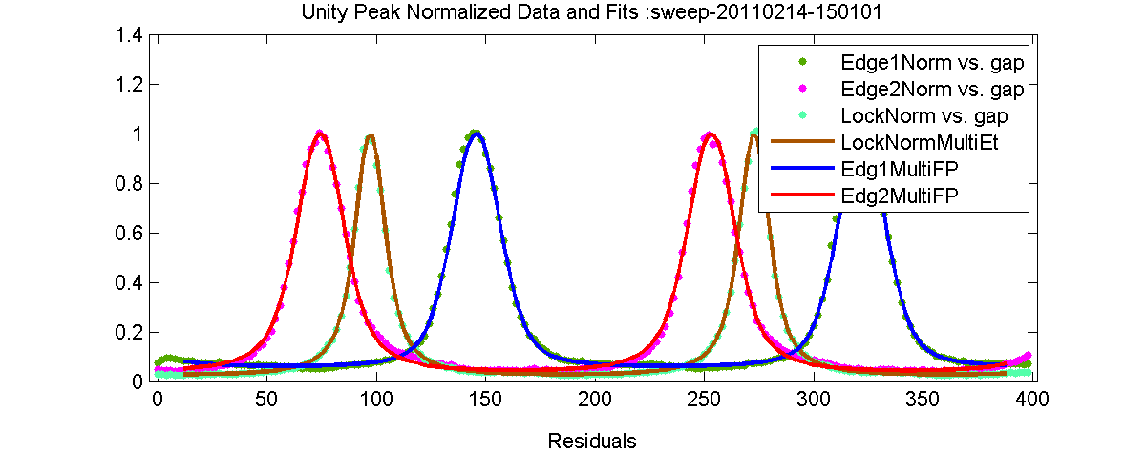
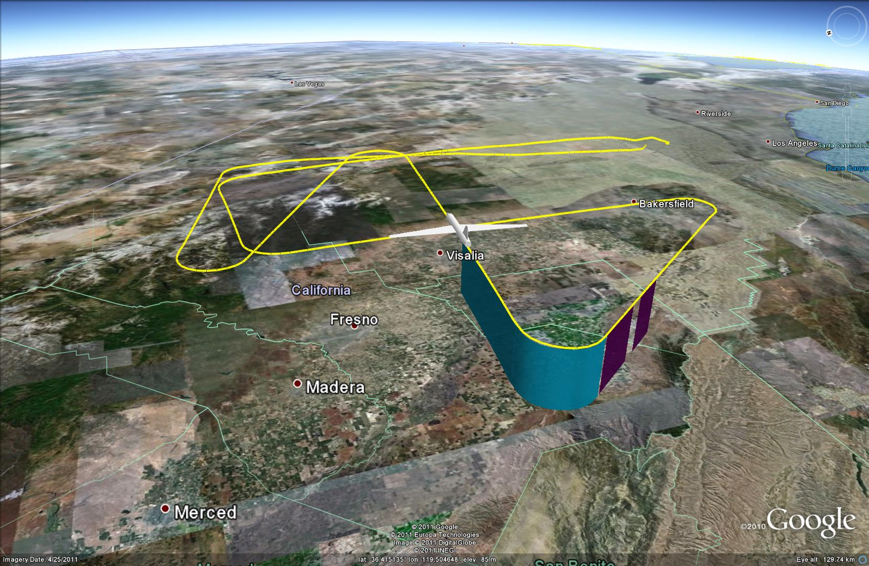
TWiLiTE Flight Test Modes Etalon Calibration

Slide 8
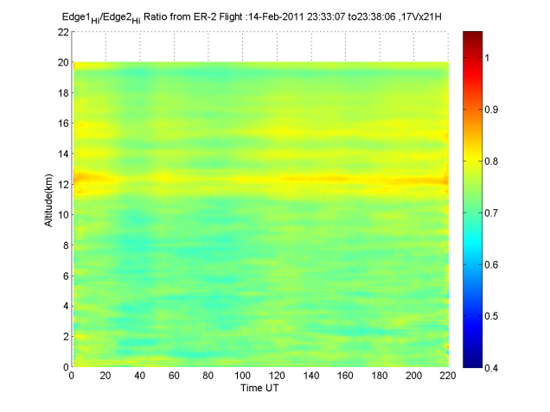
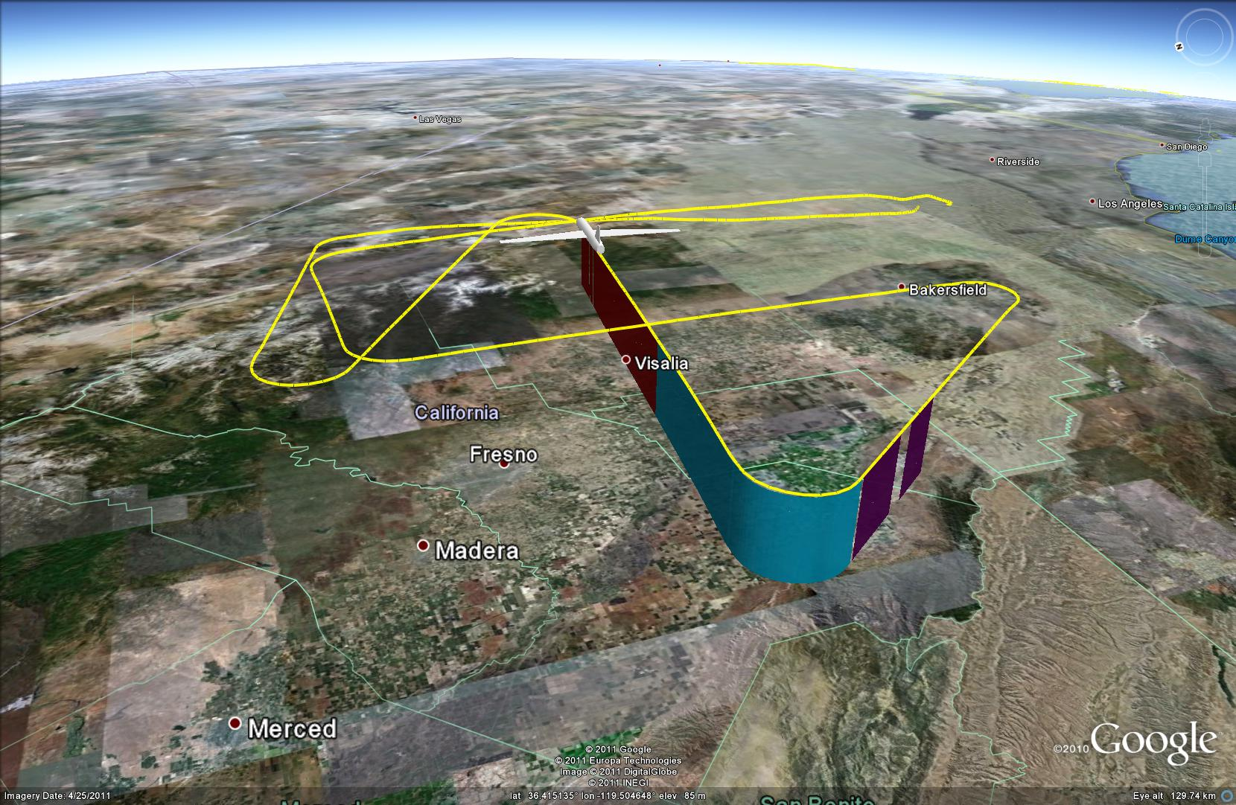
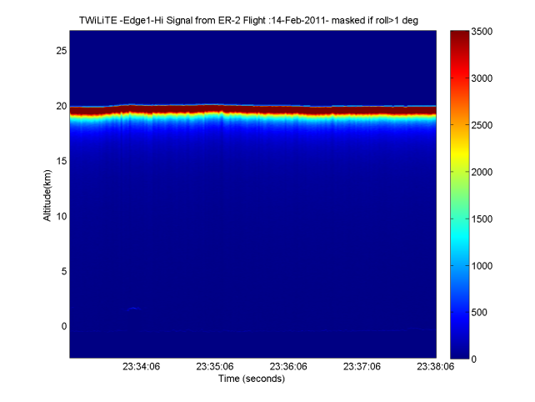
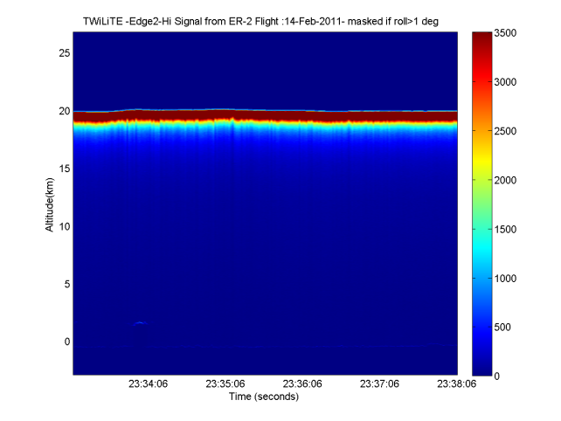
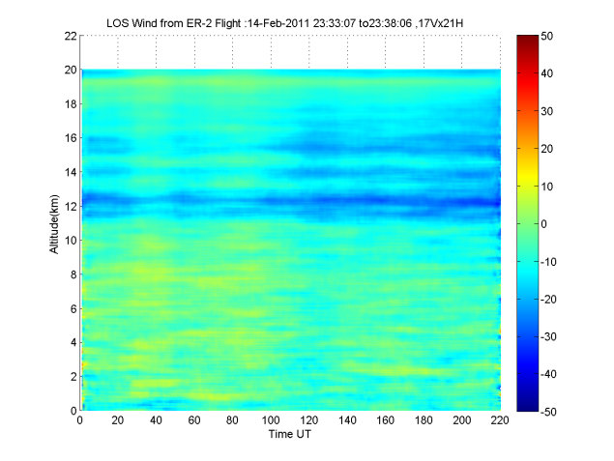
TWiLiTE Flight Test Modes
TWiLiTE Flight Test Modes Science Data Acquisition
Edge1
Ratio=Edge1/Edge2
Merge lidar and GPS/IMU
Background subtracted
Deadtime corrected
Averaged in range
N shots averaged
Ratio signals E1/E2
1, Utilize etalon scan with simulated Rayleigh Brillouin spectral lineshape to generate calibration curve .
2. Calculate LOS wind speed
3. Apply correction for aircraft motion*
Edge2
LOS Wind Speed

Slide 9
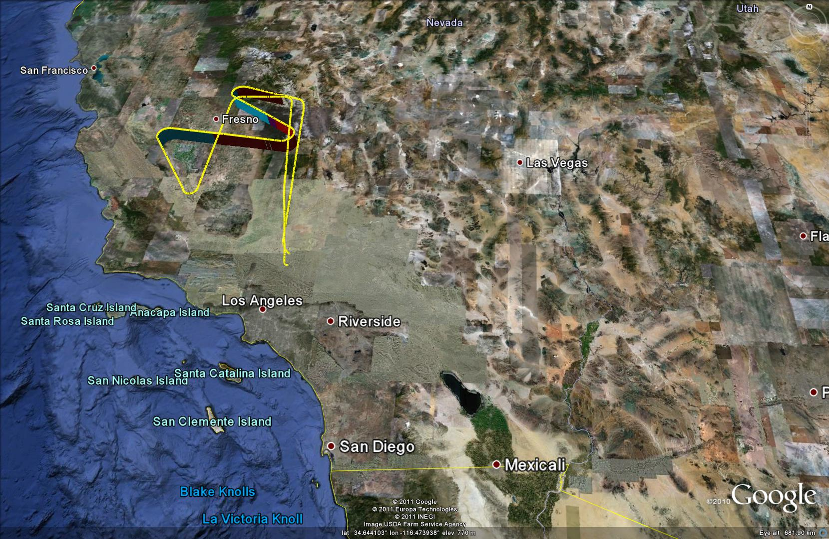
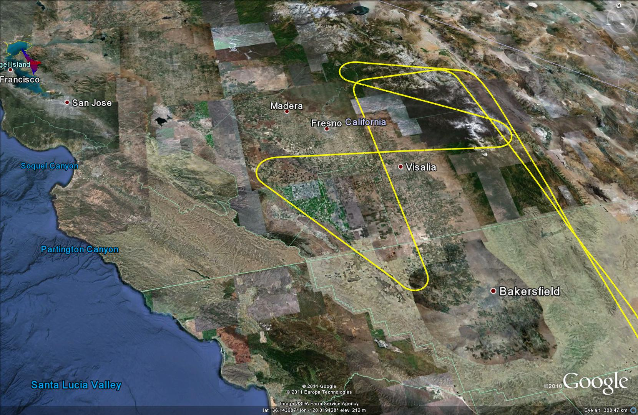
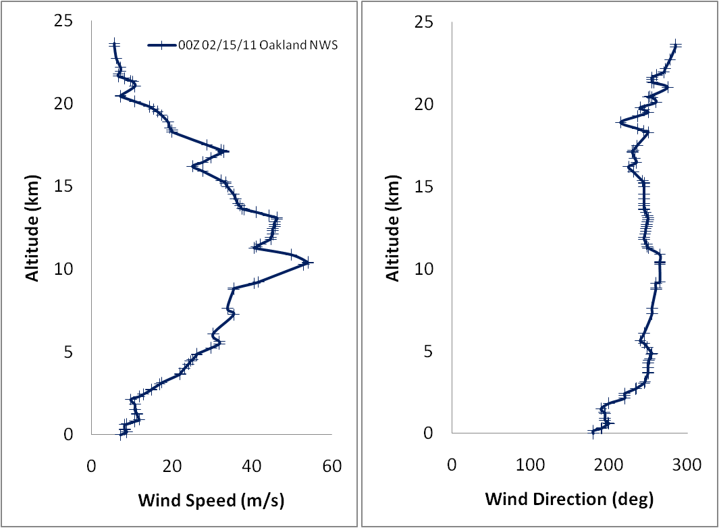
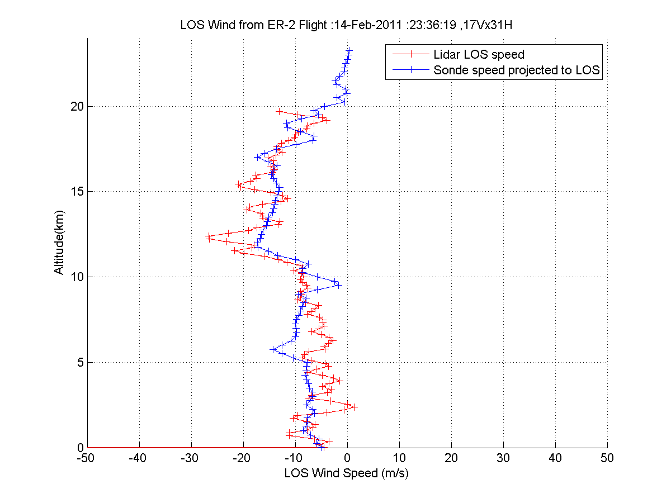
Feb 14, 2011 ER-2 Flight Track- Oakland NWS sonde comparison
Oakland NWS Sonde 00Z Feb 15, 2011
Sonde Speed Projected to TWiLiTE LOS azimuth

Slide 10
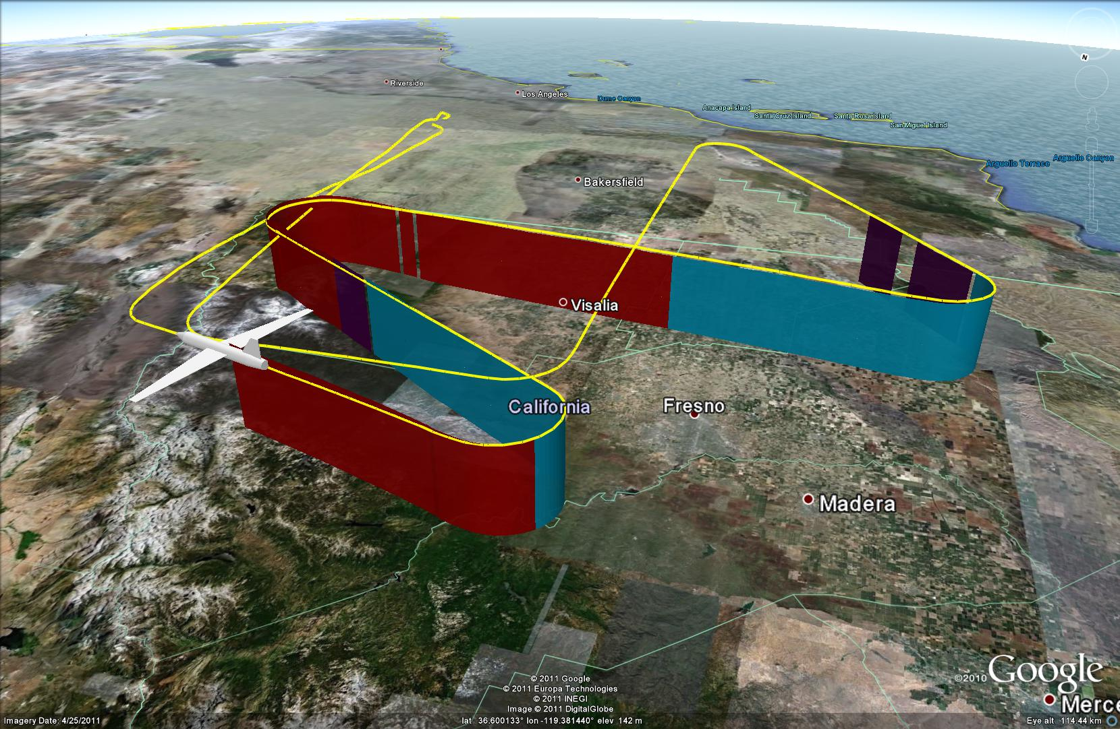
Feb 14, 2011 ER-2 Flight Track
S2
S1
S4
S3

Slide 11
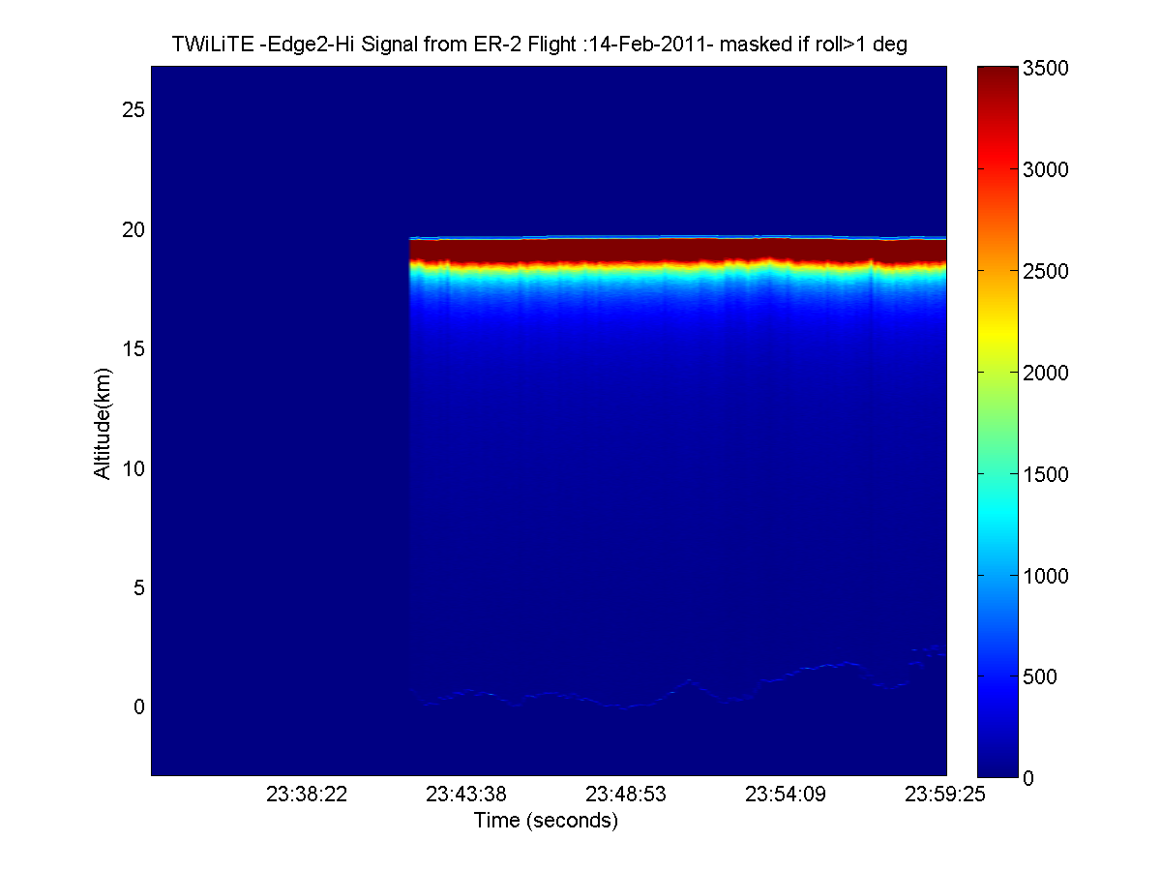
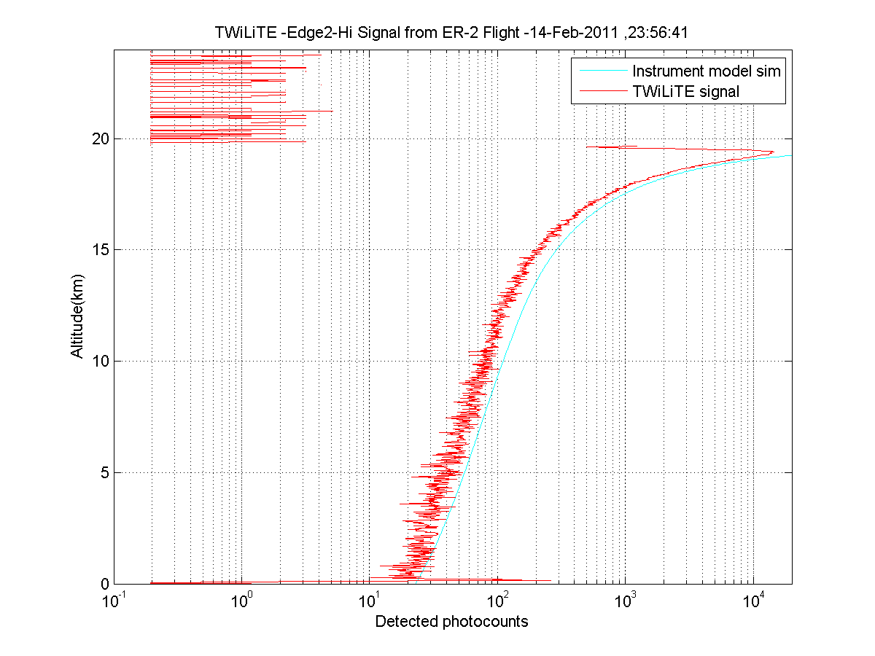
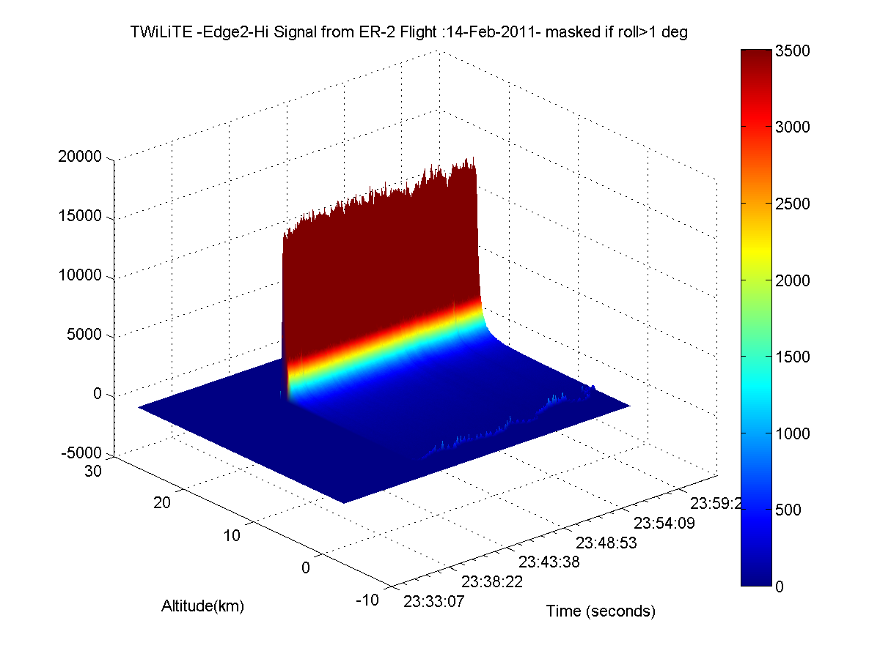
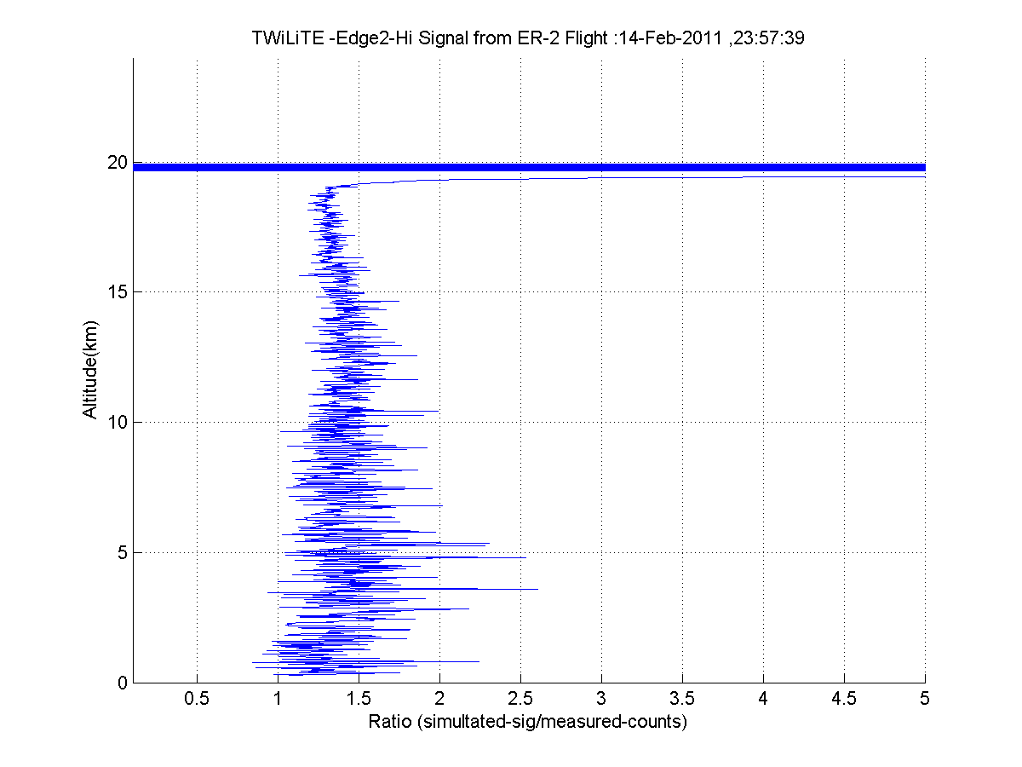
February 14 flight over California Central Valley-Track S4 Δt_{avg}=1 second, ΔR=30 m, Δz=21 m

Slide 12
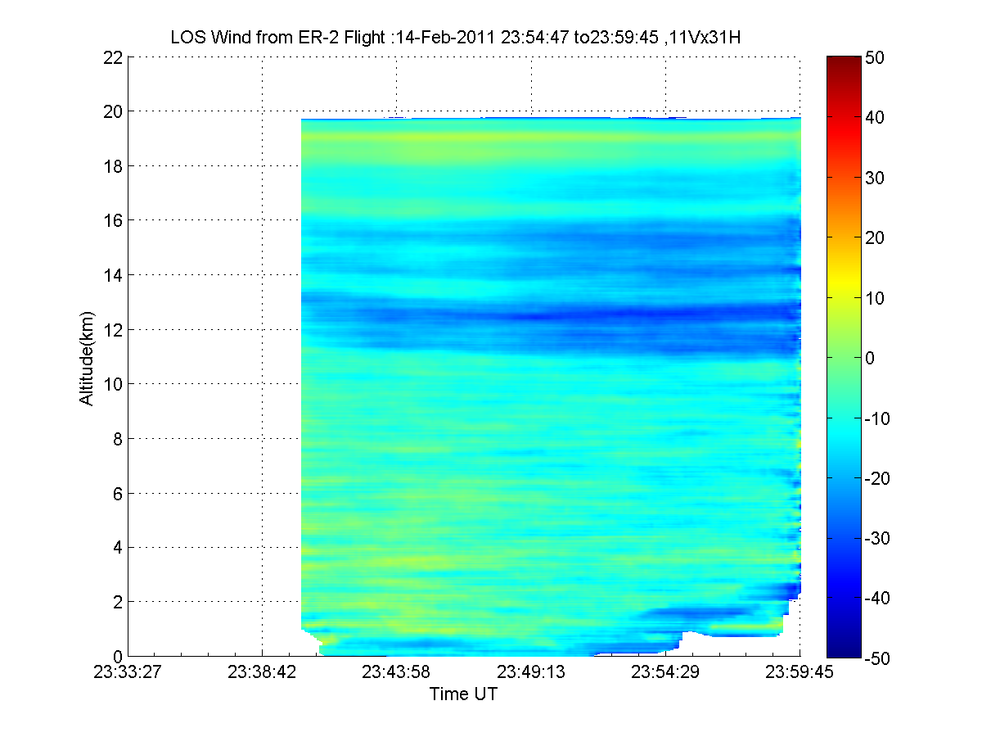
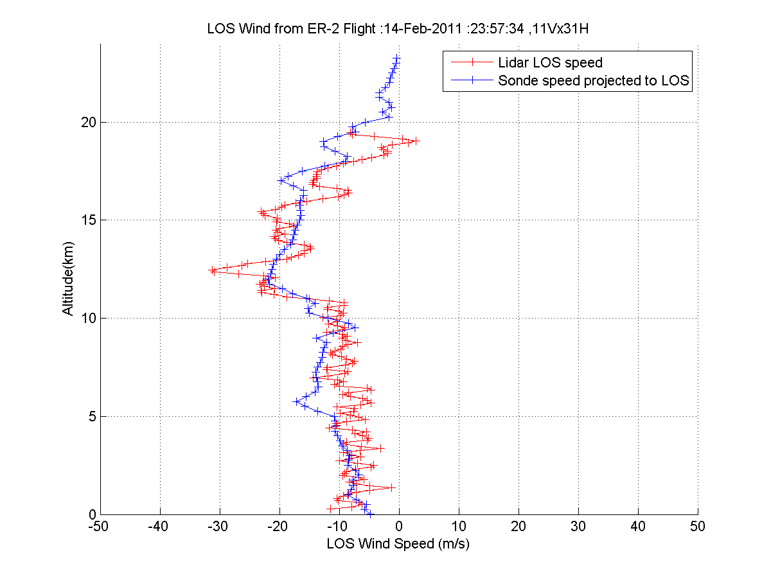
February 14 flight over California Central Valley Δt_{avg}=11 second Δz=253 m
11x31-139

Slide 13
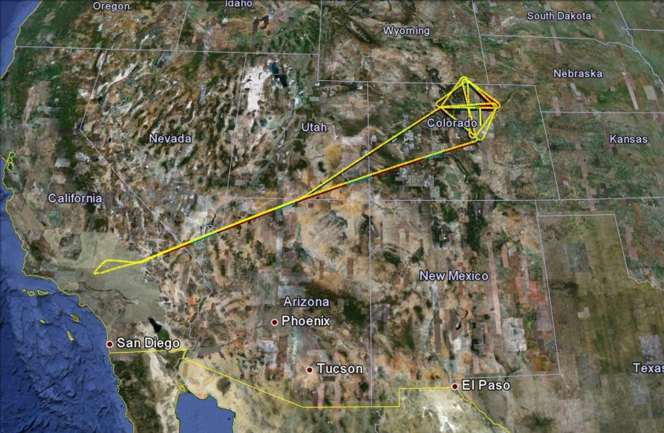
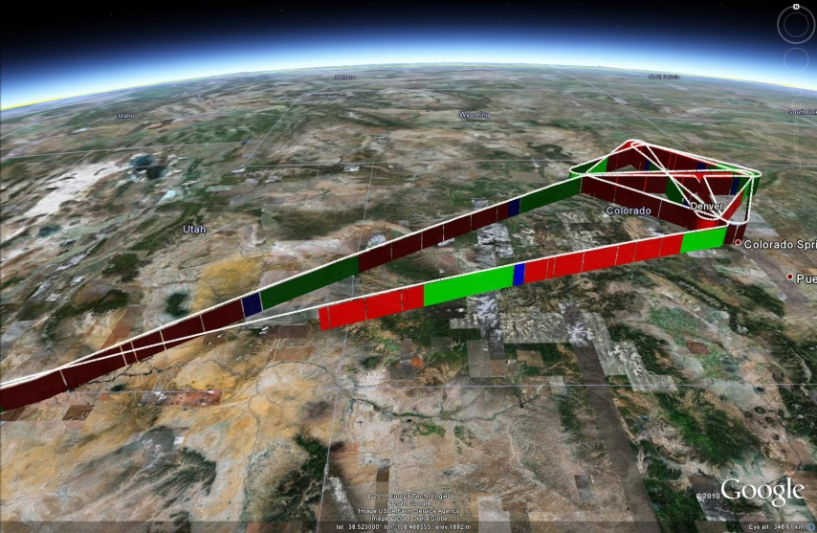
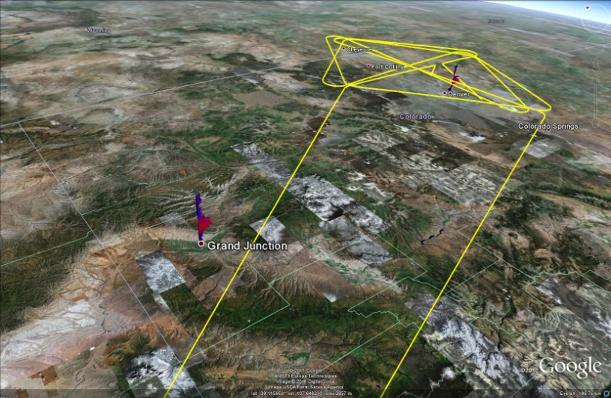
February 15, 2011 flight Palmdale, CA to Denver, CO

Slide 14
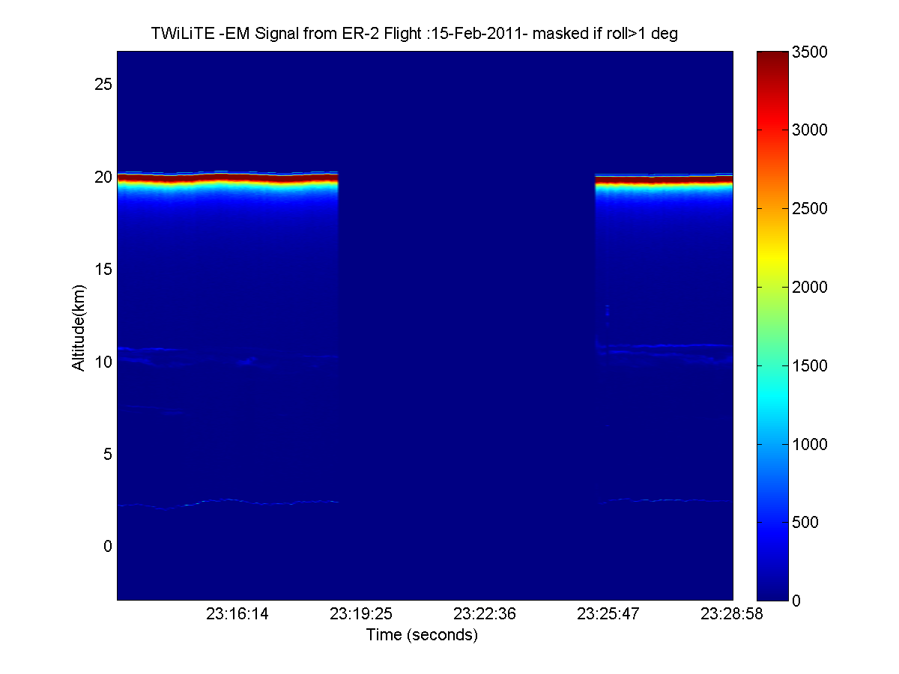
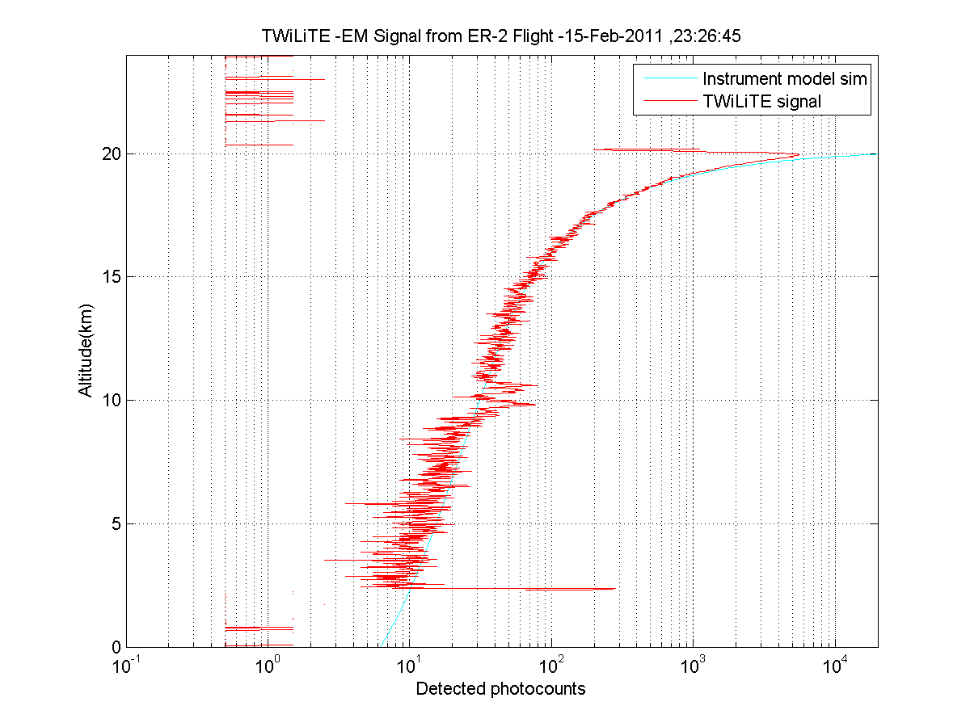
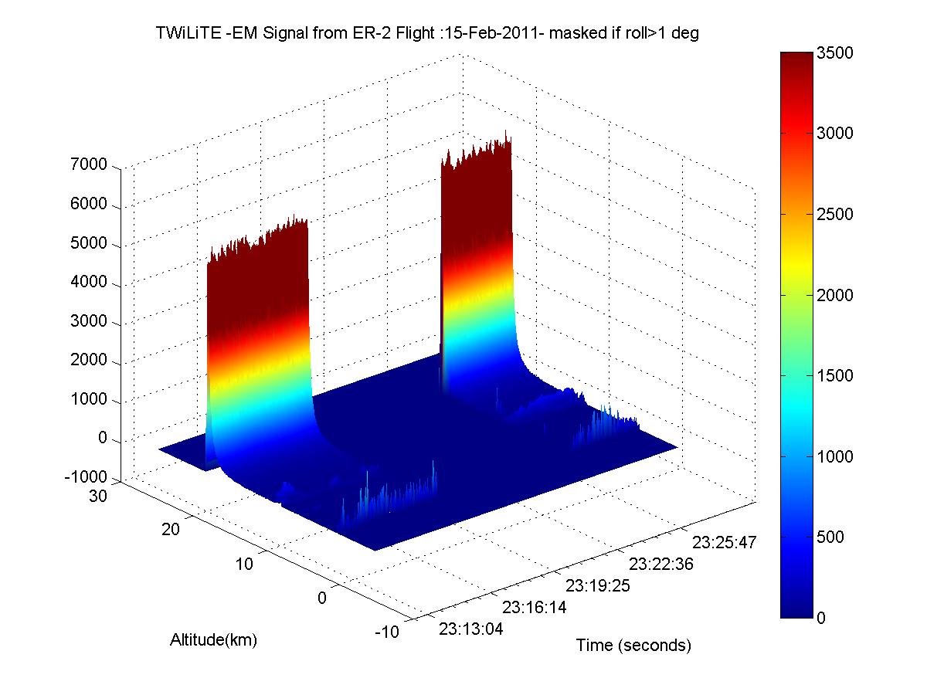
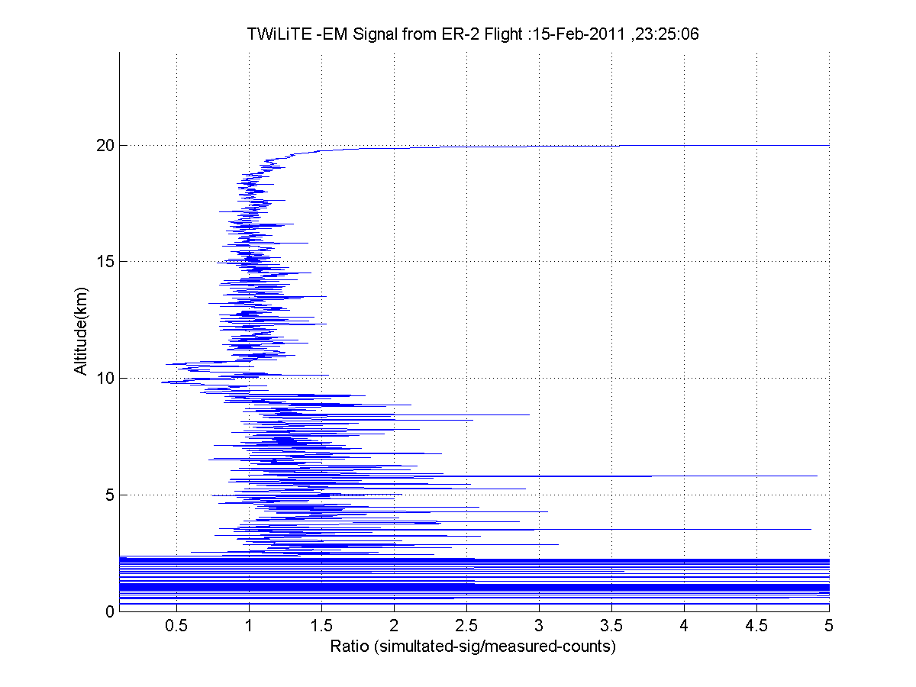
February 15 , 2011 Flight – Track 28 Δt_{avg}=1 second, ΔR=30 m, Δz=21 m

Slide 15
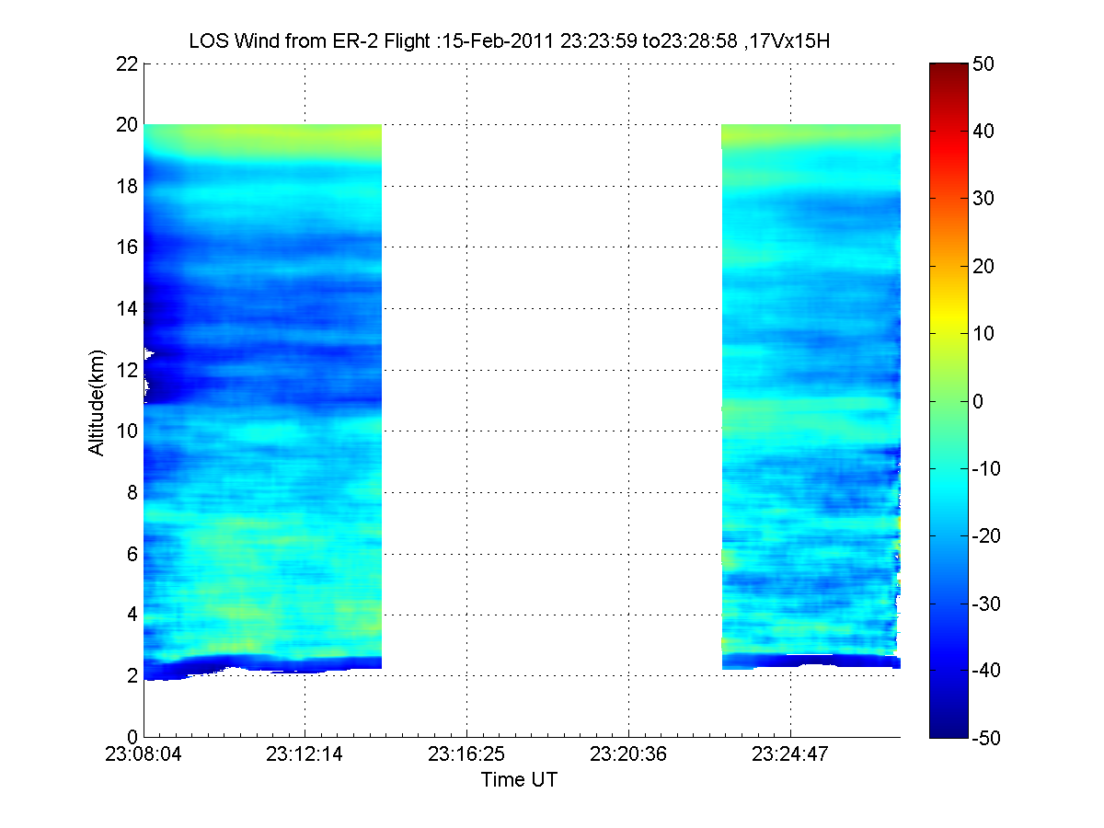
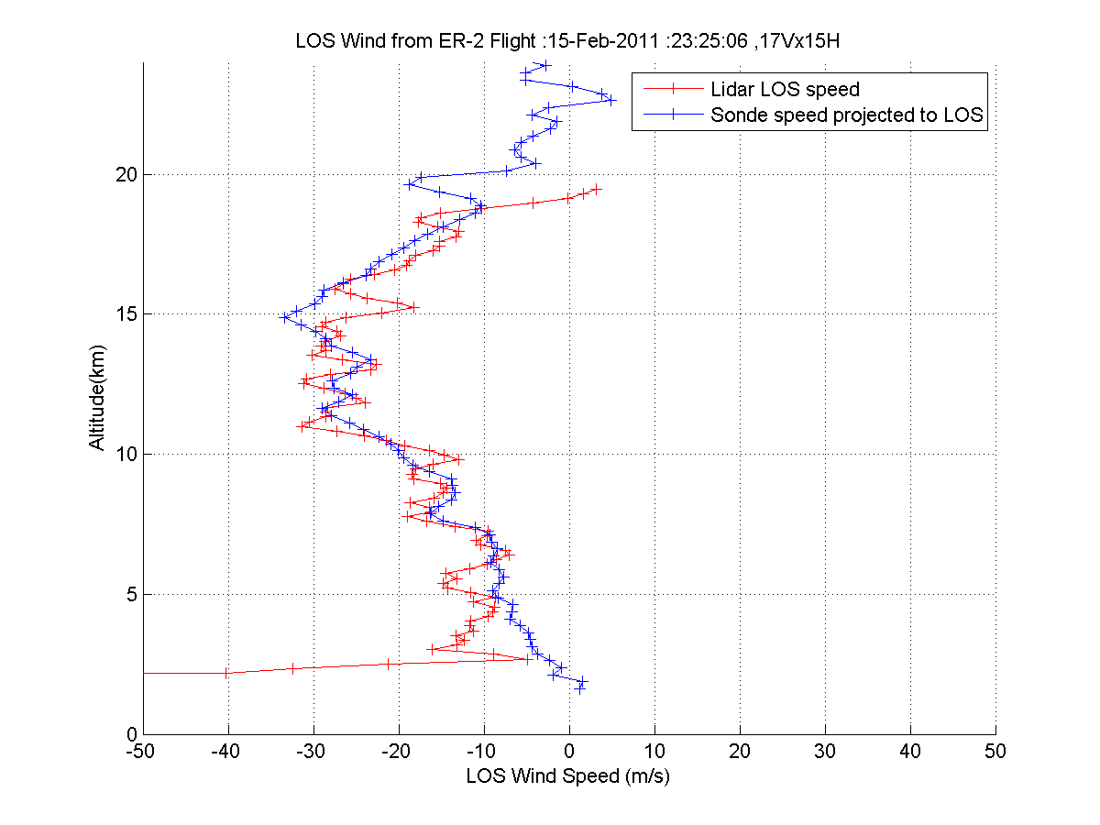
February 15,2011 flight Palmdale, CA to Denver, CO - 28 Δt_{avg}=11 seconds, Δz=253 m
17x11-139

Slide 16


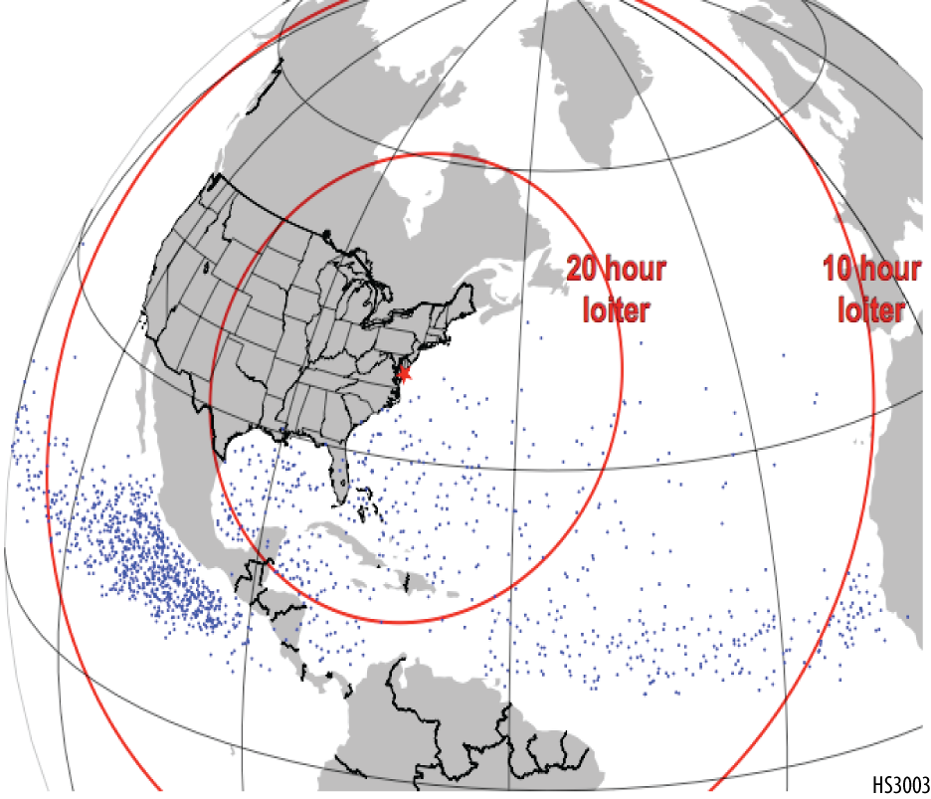
HS3 Mission Overview
• Two aircraft, one equipped for the storm environment, one for over-storm flights
• Deployments of GHs from the East Coast— Wallops Flight Facility in VA
• One-month deployments in 2012, 2013, and 2014
• 275 flight hours per deployment (10-11 flights)
16 h
loiter
6 h
loiter
Dots indicate genesis locations. Range rings assume 26-h flights.

Slide 17
Overarching Science Questions
What impact does the large-scale environment have on intensity change?
What is the role of storm internal processes in intensification?
To what extent are these processes predictable?

Slide 18
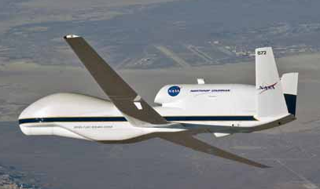
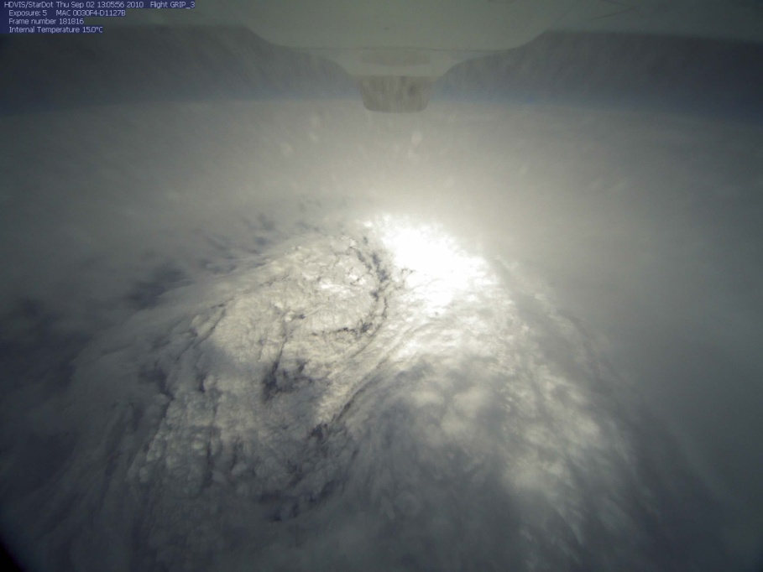
NASA’s Global Hawk UAS
Hurricane Earl’s eye as seen from the GH
Cruise Climb from 56-65K ft
(max takeoff weight)

Slide 19
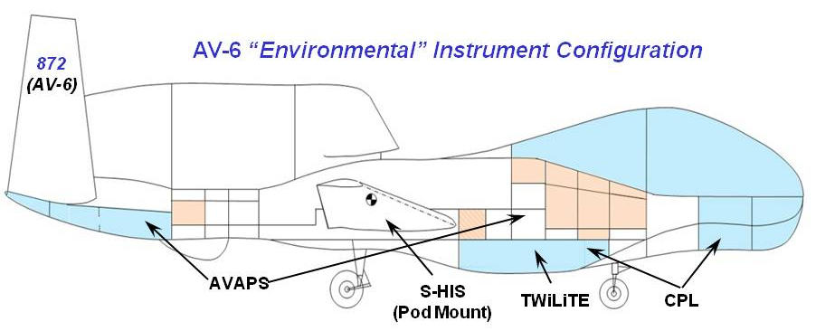
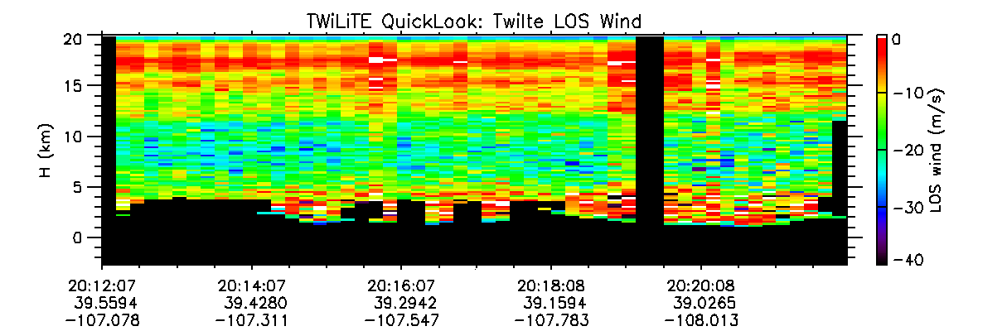
Environmental Payload
2013-2014
NOAA
NASA/GSFC
U. Wisc.
NASA/GSFC
Temperature
TWiLiTE wind lidar to be added in 2013
Relative Humidity
Rocky Mountains

Slide 20
TWiLiTE-GH Objectives
The intent of this effort is to:
Reconfigure TWiLiTE to fly onboard the Global Hawk (AV-6) in support of the upcoming HS3 mission
Utilize the AESA 360 zone 25 deep fairing
Maintain compatibility with the ER-2
Deploy current HOE telescope, maintaining compatibility with new ACT telescope

Slide 21

Schedule
Project I&T Milestones:
August 2011: PDR-level designs of TWiLiTE-GH interfaces (all options) presented at TIM
January 2012: Selected HOE as primary telescope/optical bench for HS3
April 2012: Review CDR-level designs of TWiLiTE-GH interfaces with DFRC
June 2012: Pallets delivered to enable fit-checks at Sigma
July 2012: ER-2 test flights to demonstrate instrument functionality, pallet fit-check at DFRC
September 2012: Completion of ER-2 flight testing & reporting of reconfigured TWiLiTE
March 2013: TWiLiTE test flights on GH
June 2013: TWiLiTE integrated on AV-6 for HS3 operations
July-September 2013: HS3 operations from WFF

Slide 22
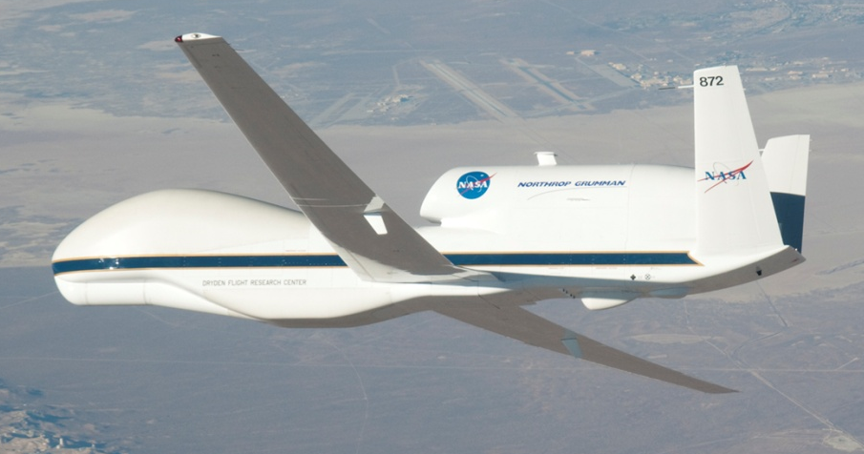
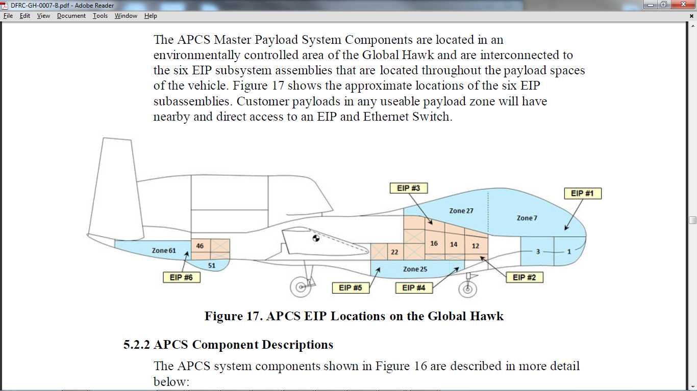
TWiLiTE-GH Overview
TWiLiTE mounted
in zone 25

Slide 23

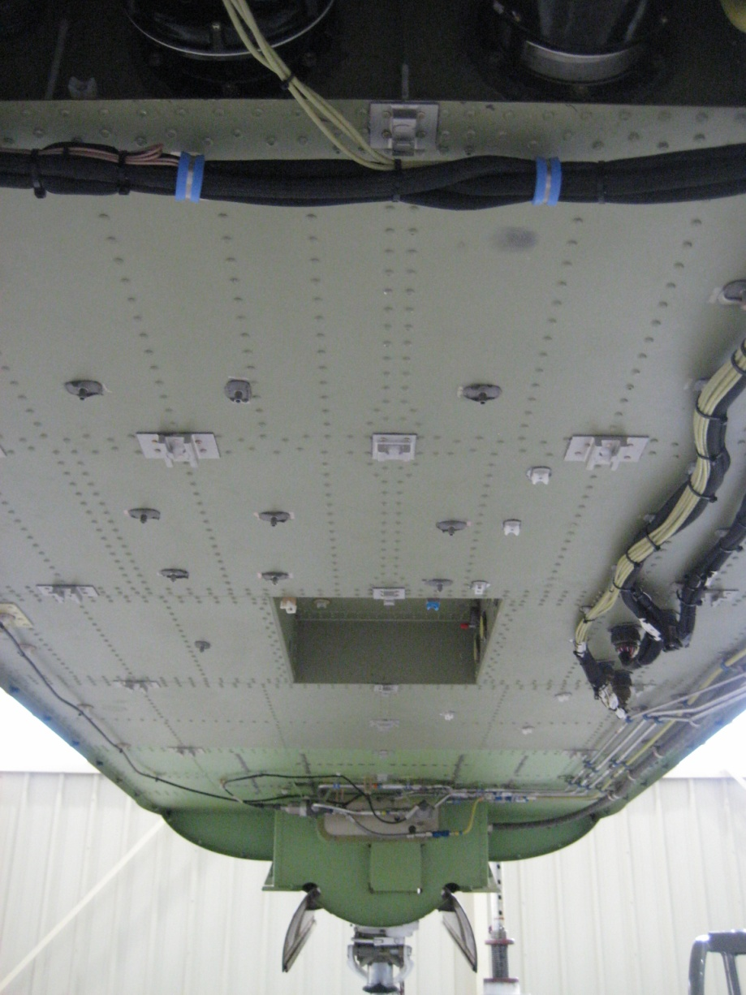
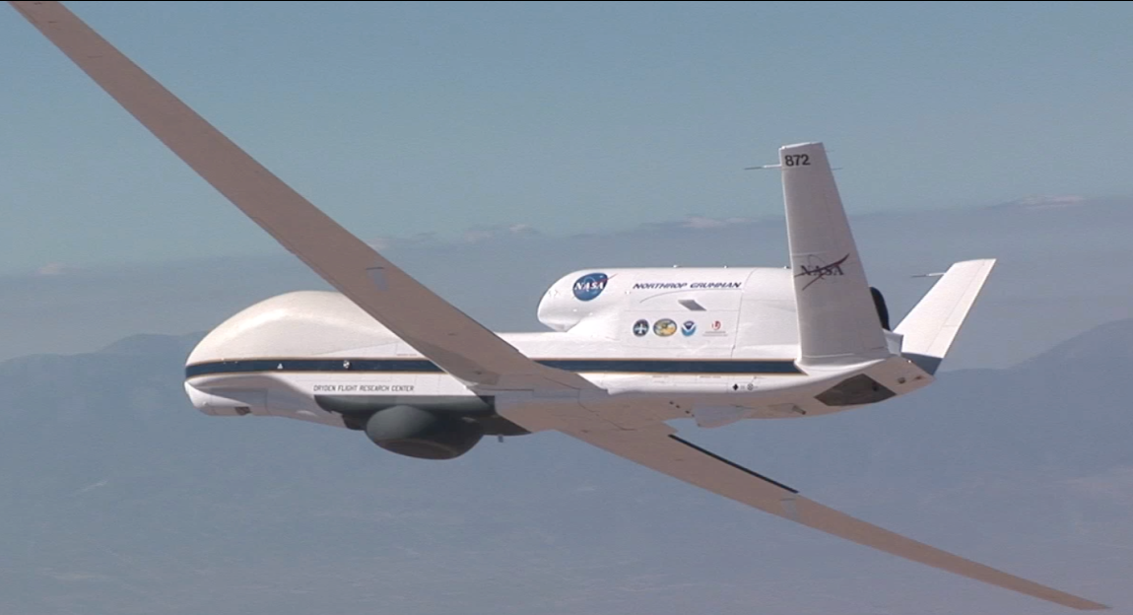
TWiLiTE-GH Overview

Slide 24
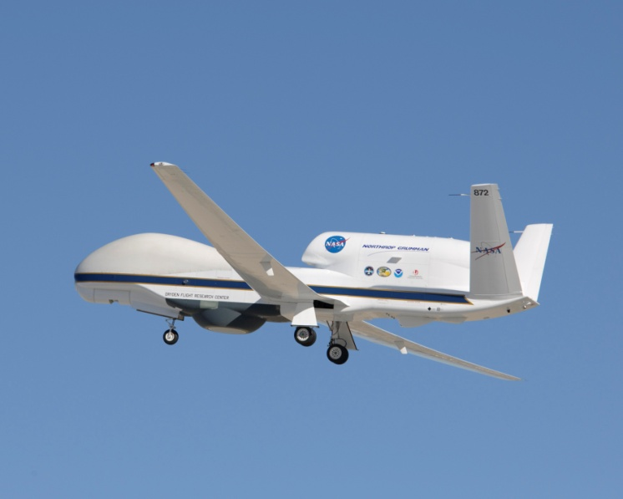
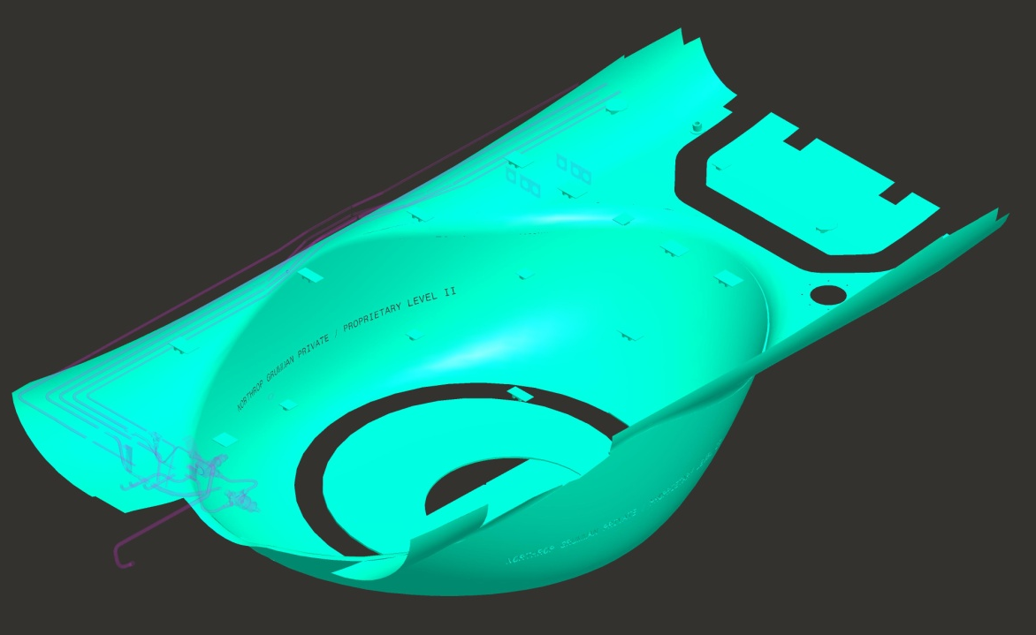
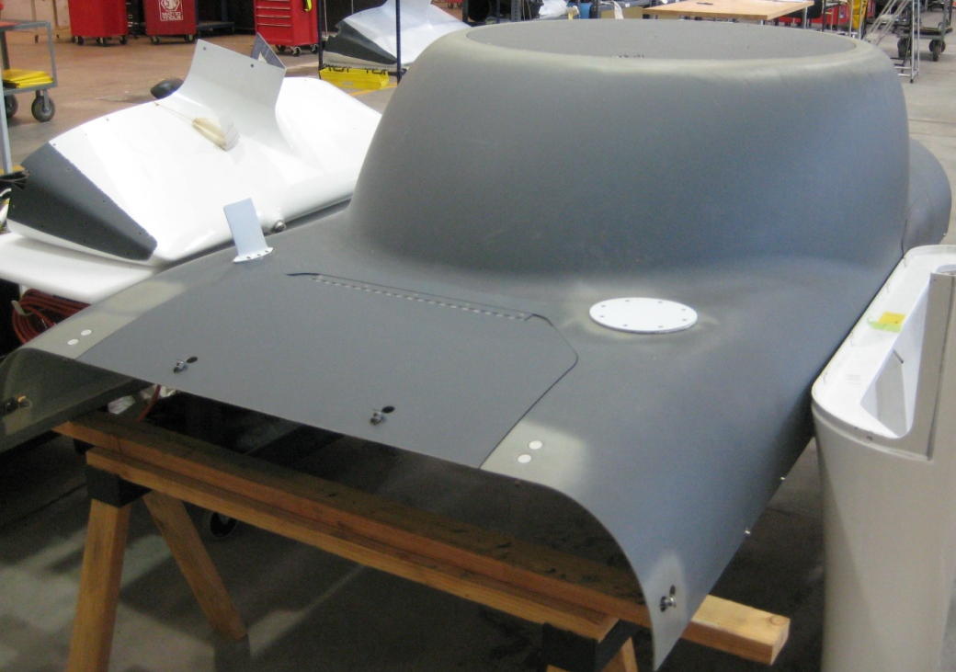
AESA 360 Fairing

Slide 25
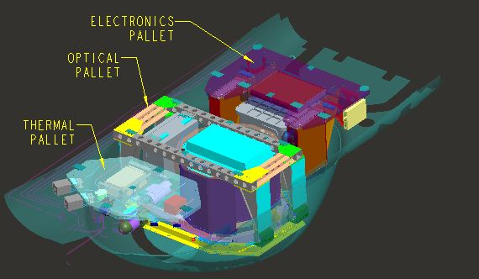
TWiLiTE-GH
Instrument mounted on 3 pallets
Electronics
Optics
Thermal

Slide 26
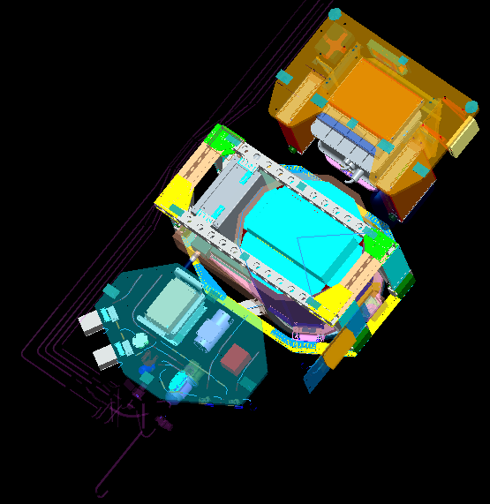
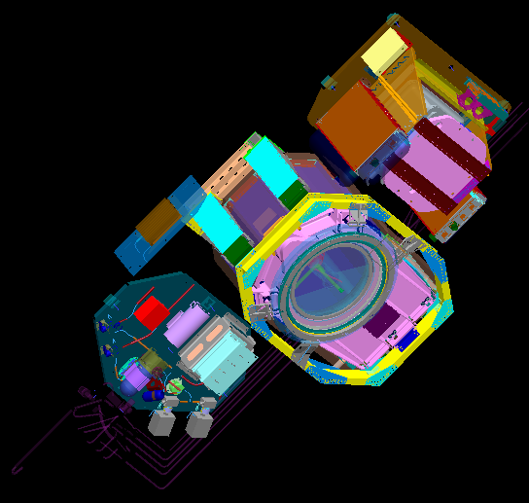
TWiLiTE-GH
Electronics pallet
Optics pallet
Thermal pallet

Slide 27
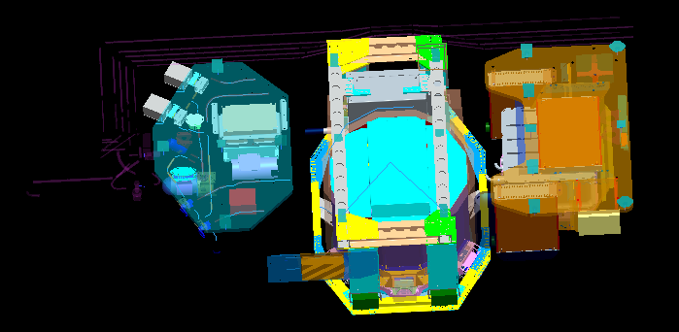
TWiLiTE-GH
Thermal pallet
Optics pallet
Electronics pallet

Slide 28

TWiLiTE-GH

Slide 29


Electronics Pallet
Outer dimensions: 41” x 27” x 20”
Hard
drive
Backup
battery
Data, power
boxes (3X)
Receiver
Heater block

Slide 30


Thermal Pallet
GSE
valves (2X)
PID enclosure
Flow
meter
EIP
assembly
Proportional
valves (2X)
Pump
Outer dimensions: 40” x 27” x 11”

Slide 31


Optics Pallet
Outer dimensions: 48” x 34” x 28”
Window
HOE telescope
Optical bench
LOM
LEM

Slide 32
Conclusions and Future plans
In October, 2009 and February, 2011 we completed two deployments to Edwards AFB to integrate TWiLiTE in the ER-2 Q-Bay and fly 40 hours of test flights.
During these flights TWiLiTE demonstrated fully autonomous operation of the major lidar functions including etalon calibration, telescope/laser bore sight alignment and science data acquisition
Collected >9 hours of LOS wind profile measurements (~3000 profiles @11 second average, 253 m vertical resolution) with a variety of atmsospheric conditions. Comparison with NWS sondes shows excellent agreement.
Additional flight tests of TWiLiTE on the ER-2 are planned for July, 2012.
TWiLiTE will be reconfigured to fly in Zone 25 of the NASA Global Hawk for the HS3 EV-1 Mission.

Slide 33
Backups

Slide 34

2007 NRC Decadal Survey Recommendations for 3DWinds
3D Tropospheric Winds mission called “transformational” and ranked #1 by Weather panel. with concurrence by Water panel. Overall prioritized in 3rd tier of 15 NASA recommended missions.
“The Panel strongly recommends an aggressive program early on to address the high-risk components of the instrument package, and then design, build, aircraft-test, and ultimately conduct space-based flights of a prototype Hybrid Doppler Wind Lidar (HDWL).”
“The Panel recommends a phased development of the HDWL mission with
the following approach:
Stage 1: Design, develop and demonstrate a prototype HDWL system capable of global wind measurements.
Stage II: Launch of a HDWL system that would meet fully-operational threshold tropospheric wind measurement requirements

Slide 35
Doppler Lidar Measurement Concept
DOPPLER RECEIVER - Multiple flavors dependent on scattering target -
Aerosol return gives high accuracy and high spatial and temporal resolution when aerosols present
Molecular return gives lower accuracy and resolution but signal is always there
Backscattered Spectrum
Δν_{DOP}
Aerosol (λ⁻²)
Molecular (λ⁻⁴)
Frequency

Slide 36
Double Edge Measurement Principle
Molecular Channel at 355 nm
Δν_{DOP}
Aerosol
Edge Filter 1
Edge Filter 2
Molecular
Frequency

Slide 37








TWiLiTE Compatible
NASA Airborne Science Platforms
36 hrs duration
Unmanned vehicle
6-8 hrs duration
Unattended operation
Global Hawk
25
20
15
10
5
ER2
WB57
TWiLiTE configured for DC8 Nadir Port 7
(AITT)
Max Altitude (km)
DC8
TWiLiTE configured for Global Hawk Zone 25
(HS3)
TWiLiTE configured for WB57 3’ Pallet
(ESTO IIP04)
TWiLiTE configured for ER-2 Q-Bay
(ESTO IIP04)

Slide 38

TWiLiTE Modular Assembly-
IIP ER-2 Configuration
2A
2B
1
2C
5
3
6
4
7
Doppler receiver (Notes: insulated pressurized box; vibration isolated from frame; on liquid cooling loop; weighs about 100 lbs)
A) Data system electronic box; B) power distribution box; C) laser electronics module (LEM)
Laser Optical Module (LOM) (Notes: insulated pressurized box; on liquid cooling loop; 3 pt titanium flex mounts to opt bench)
Optical Bench
HOE telescope
ER-2 Qbay instrument pallet (mechanical interface defined by aircraft.)
80-20 structure (modular framework can be easily redesigned for different aircraft)

Slide 39




TWiLiTE Direct Detection Wind Lidar Key Technologies
 | Entrance TRL | Exit TRL
High spectral resolution all solid state laser transmitter | 4 | 5
High spectral resolution optical filters | 4 | 5
Efficient 355 nm photon counting molecular Doppler receiver technologies | 4 | 5
Novel UV Holographic Optical Element telescopes and scanning optics | 3 | 5

Slide 40

TWiLiTE Laser
FUNCTIONS:
Generates single frequency uv laser pulses.
Injection seeded Nd:YAG ring oscillator with single amplifier
Frequency tripled to λ=355 nm
Pulse energy = 35 mJ @ 355 nm
Pulse Rep Frequency = 200 pps
Optical canister is 28x33x14 cm³
Assembled laser optical (gold) and electronics (black) modules
FEATURES:
High 3rd harmonic conversion efficiency (~50%).
Excellent beam quality (M²<1.5 @ 355 nm)
Compact, ruggedized laser optical and electronics modules.
Fully autonomous laser control software
STATUS :
Subsystem tested in lab
Integrated in TWiLiTE system
System level demo on ground
Flight operation in ER-2
Remaining issues: None

Slide 41


TWiLiTE Doppler Receiver
FUNCTIONS:
Fiber optic delivers atmospheric backscattered signals from the telescope.
Doppler shift measured using high resolution tunable Fabry-Perot etalon.
Photomultipler tubes operating in photon counting mode measure atmospheric signals.
Vibration isolate, temperature controlled pressure vessel minimizes environmental effects.
Fiber pickoff of small fraction of transmitted laser signal used to measure outgoing laser frequency
Doppler receiver modules (left) are enclosed in an environmentally controlled vessel (right)
FEATURES:
Performance improvements*
Volume reduced by 90%
Optical path lengths minimized to improve mechanical, thermal stability
Throughput increased by 60%
Signal dynamic range increased by 2 orders of magnitude
* versus 1st gen ground-based DDDL lidar receiver
STATUS :
Subsystem tested in lab
Integrated in TWiLiTE system
System level demo on ground
Flight operation in ER-2
Remaining issues: None

Slide 42



TWiLiTE Tunable Fabry-Perot Etalon and Digital Controller
FUNCTIONS:
Designed to measured Doppler frequency shift using molecular ‘double edge’ approach.
Step coatings in three sub-apertures offset the resonance peak of the etalon to produce the two edge channel filters used for the wind measurement and a locking channel which is used to measure the outgoing laser frequency
The etalon plates are piezoelectrically tunable and have capacitive sensors to maintain plate paralellism
Lock
Edge2
Edge1
Fabry Perot Etalon
Triple aperture step etalon (left) has 3 sub-apertures offset in frequency as shown in the etalon calibration scan (right) from the Oct 1, 2009 ER-2 flight.
FEATURES:
50 mm clear aperture plates
Three 20 mm diameter sub-apertures defined by step coatings
9 mm gap
16.6 GHz FSR
Plate reflectivity = 0.75
STATUS :
Subsystem tested in lab
Integrated in TWiLiTE system
System level demo on ground
Flight operation in ER-2
Remaining issues: None

Slide 43


TWiLiTE Holographic Telescope
FUNCTIONS:
Transmits laser pulses co-aligned with telescope optical axis
Collect laser backscattered light and focus into multimode fiber.
Rotating HOE to scan laser and FOV in azimuth
Provide precise pointing knowledge to C&DH system
Holographic Optical Element (HOE) telescope seen from below. The HOE is mounted in a rotating ring bearing in order to scan. The HOE focuses the collected laser light and diffracts the FOV off-nadir by 45 deg
FEATURES:
Primary Optic: Rotating 40-cm diameter HOE, 1-m focal length
45-deg off-nadir FOV
Compact, folded optical path
Coaxial laser transmission
Active laser bore-sight and alignment system
STATUS :
Subsystem tested in lab
Integrated in TWiLiTE system
System level demo on ground
Flight demo in ER-2 (AITT)
Remaining issues:
Azimuth step stare scanning
Auto-alignment boresight maintenance (software)
Transmission down by 2-3x (thermal effects: HOE
efficiency; defocus )

Slide 44




February 14 flight over California Central Valley-Track S1 Δt_{avg}=1 second, ΔR=30 m, Δz=21 m

Slide 45


February 14 flight over California Central Valley Δt_{avg}=11 second, Δz=253 m
11x31-139

